Slide 1
Financial Accounting
IFRS 4th Edition
Weygandt ● Kimmel ● Kieso
Chapter 2
The Recording Process

Slide 2
Chapter Preview
Companies use a set of procedures and records to keep track of transaction data more easily than in tabular format presented in Chapter 1.
This chapter introduces and illustrates these basic procedures and records.

Slide 3
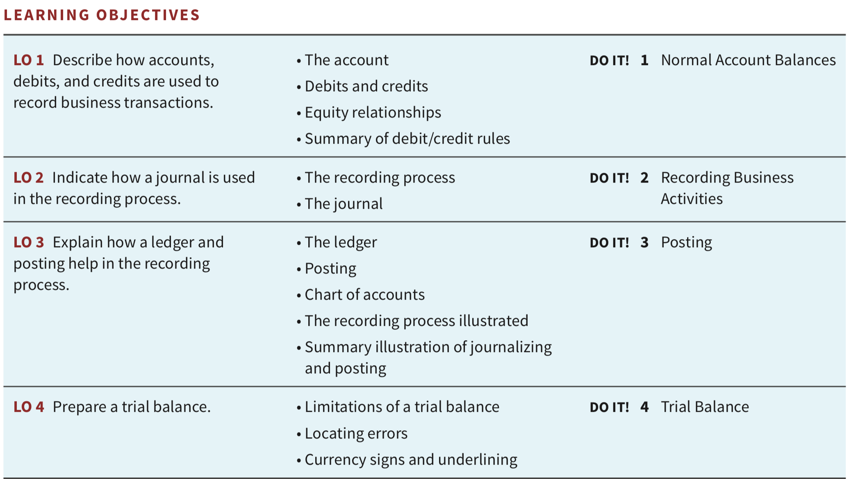
Chapter Outline

Slide 4
Learning Objective 1 Describe how accounts, debits, and credits are used to record business transactions.
LO 1

Slide 5
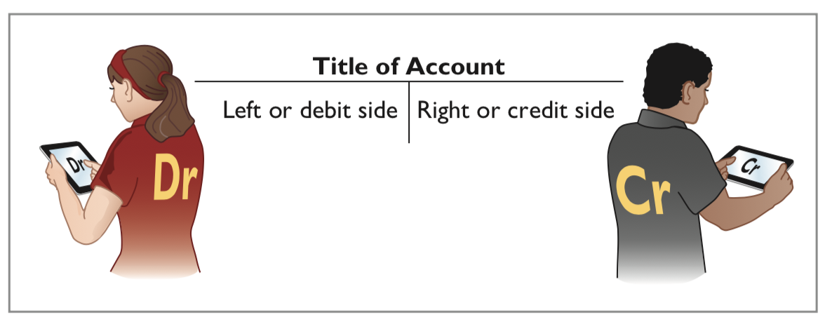

Accounts, Debits, and Credits
The Account
An account is an individual accounting record of increases and decreases in a specific asset, liability, or equity item.
In its simplest form, an account consists of three parts: (1) a title, (2) a left or debit side (Dr.), and (3) a right or credit side (Cr.).
Note: Whenever we are referring to a specific account, we capitalize the name.
Dr.과 Cr.의 뜻은?
LO 1

Slide 6
Accounts, Debits, and Credits
The Account
-
증감을 동시에 나타내기 위해서는 한 계정에 두개의 column을 만들고 한곳에는 증가를 반대쪽에는 감소를 기록한다
자산 = 부채 + 자본의 회계등식에 맞추어 각 계정의 증감을 체계적으로 기록하려면 기준이 필요하다
즉 자산의 증가는 Dr.에, 감소는 Cr.에 기록하는 것을 기준으로 삼으면
부채와 자본의 증가는 Cr.에, 감소는 Dr.에 기록한다.
그러면 회계등식에 따라서 모든 계정의 Dr.의 합계 = 모든 계정의 Cr.의 합계가 항상 성립한다.
Dr.과 Cr.의 뜻은?
LO 1

Slide 7
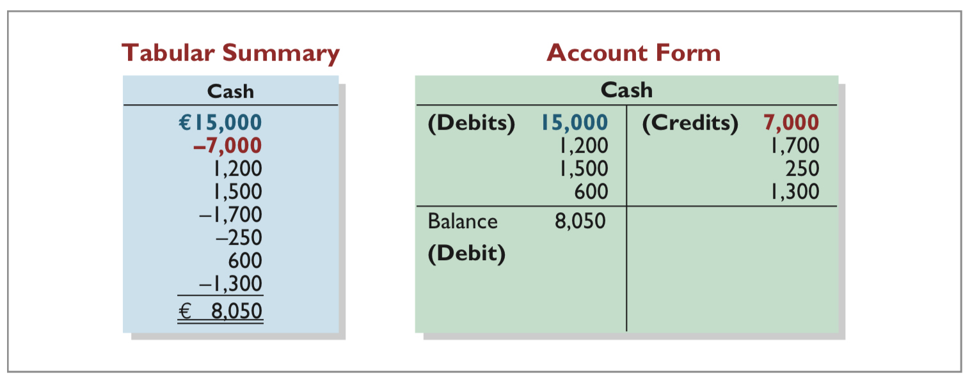
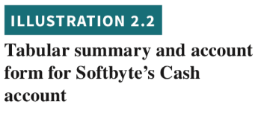
Accounts, Debits, and Credits
Debits 차변 and Credits 대변
Tabular Summary (Chapter 1) and Account Form (this Chapter)
LO 1

Slide 8

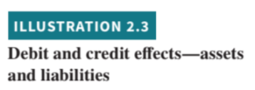
Dr./Cr. Procedures for Assets and Liabilities
Both sides of the basic equation (Assets = Liabilities + Equity) must be equal.
Increases and decreases in liabilities have to be recorded opposite from increases and decreases in assets.
Thus, increases in liabilities are entered on the right or credit side, and decreases in liabilities are entered on the left or debit side.
LO 1

Slide 9
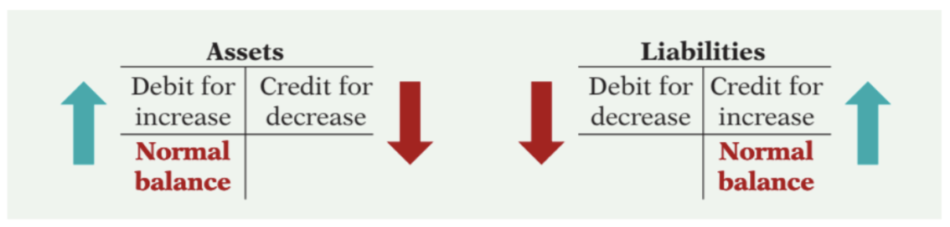
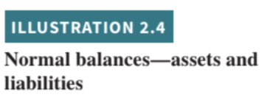
Dr./Cr. Procedures for Assets and Liabilities
Asset accounts normally show debit balances. That is, debits to a specific asset account should exceed credits to that account.
Liability accounts normally show credit balances.
That is, credits to a liability account should exceed debits to that account.
LO 1

Slide 10
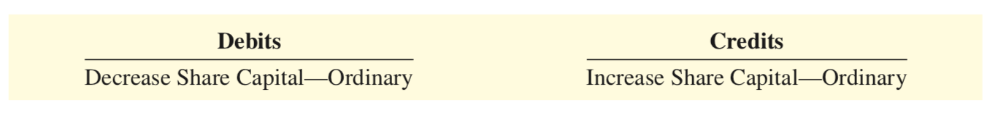
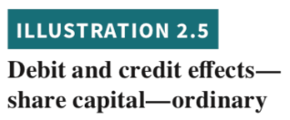
Dr./Cr. Procedures for Equity
Share Capital—Ordinary.
Companies issue share capital—ordinary in exchange for the owners’ investment paid in to the company.
Credits increase the Share Capital—Ordinary account, and debits decrease it.
LO 1

Slide 11

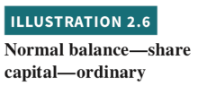
Dr./Cr. Procedures for Equity
Share Capital—Ordinary.
Knowing the normal balance in an account may help you trace errors.
Occasionally, though, an abnormal balance may be correct.
LO 1

Slide 12

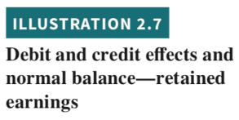
Dr./Cr. Procedures for Equity
Retained Earnings.
Share capital—ordinary, retained earnings and liabilities:
Same rules apply for debit and credit and the normal balances.
LO 1

Slide 13
Dr./Cr. Procedures for Equity
Retained Earnings.
Retained earnings is net income that is kept (retained) in the business. It represents the portion of equity that the company has accumulated through the profitable operation of the business.
Credits (net income) increase the Retained Earnings account, and debits (dividends or net losses) decrease it.
LO 1

Slide 14


Dr./Cr. Procedures for Equity
Dividends.
Dividend:
A company’s distribution to its shareholders.
The most common form of a distribution is a cash dividend.
Dividends reduce the shareholders’ claims on retained earnings.
Debits increase the Dividends account, and credits decrease it.
LO 1

Slide 15

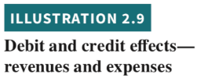
Dr./Cr. Procedures for Equity
Revenues and Expenses.
The purpose of earning revenues is to benefit the shareholders of the business. When a company recognizes revenues, equity increases.
The effect of debits and credits on revenue accounts is the same as their effect on Retained Earnings.
Expenses have the opposite effect. Expenses decrease equity.
LO 1

Slide 16
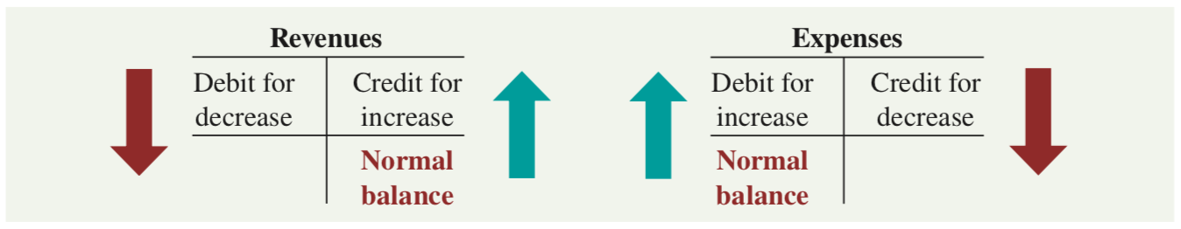
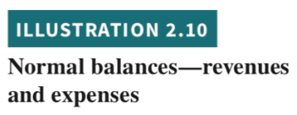
Dr./Cr. Procedures for Equity
Revenues and Expenses.
Revenue accounts are increased by credits and decreased by debits.
Expense accounts are increased by debits and decreased by credits.
Because revenues increase equity, a revenue account has the same debit/credit rules as the Retained Earnings account. Expenses have the opposite effect.
LO 1

Slide 17
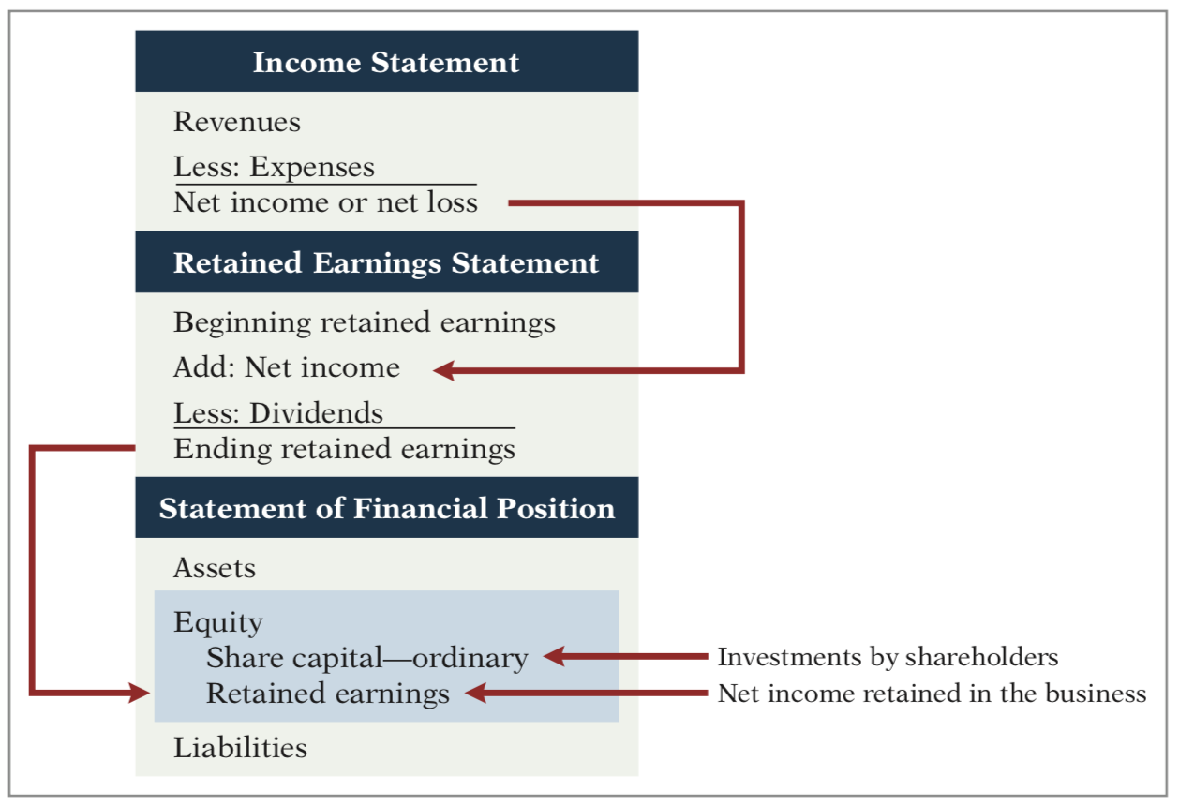

Equity Relationships
LO 1

Slide 18
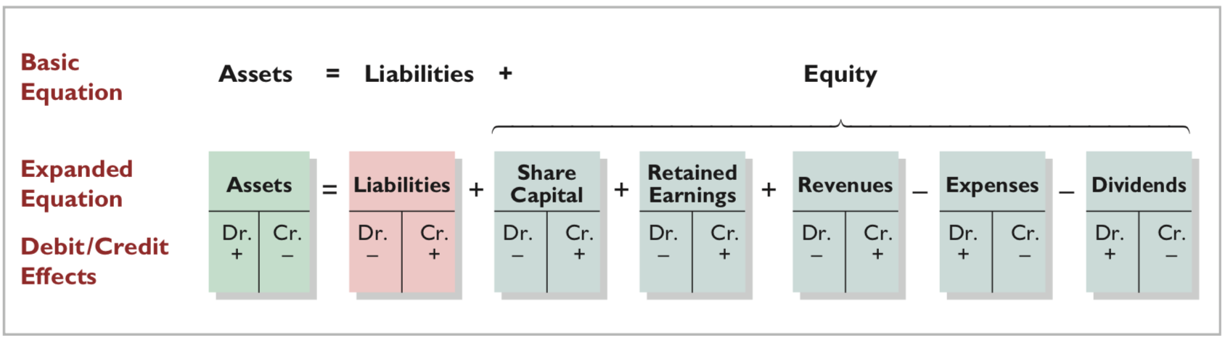
Summary of Debit/Credit Rules
LO 1

Slide 19
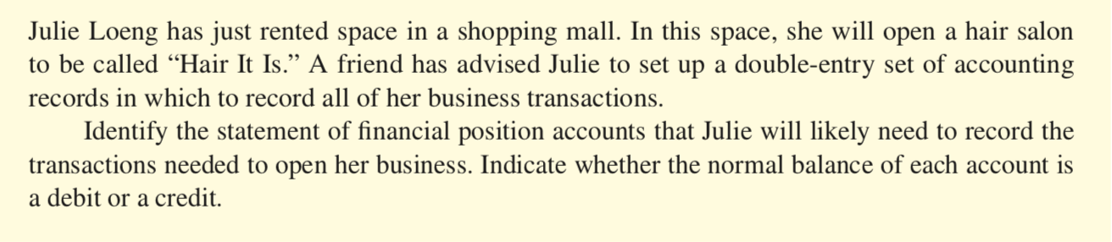
DO IT! Normal Account Balances 정상잔액
ACTION PLAN
Determine the types of accounts needed. Julie will need asset accounts for each different type of asset invested in the business and liability accounts for any debts incurred.
Understand the types of equity accounts. Only Share Capital—Ordinary will be needed when Julie begins the business. Other equity accounts will be needed later.
LO 1

Slide 20
DO IT! Normal Account Balances
Solution
Julie would likely need the following accounts in which to record the transactions necessary to ready her hair salon for opening day:
Cash (debit balance) Equipment (debit balance)
Supplies (debit balance)
Accounts Payable (credit balance)
If she borrows money:
Notes Payable (credit balance)
Share Capital—Ordinary (credit balance)
Related exercise material: BE2.1, BE2.2, DO IT! 2.1, E2.1, and E2.2.
LO 1

Slide 21
Learning Objective 2 Indicate how a journal is used in the recording process.
LO 2

Slide 22
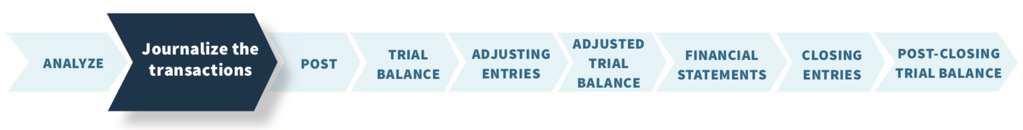
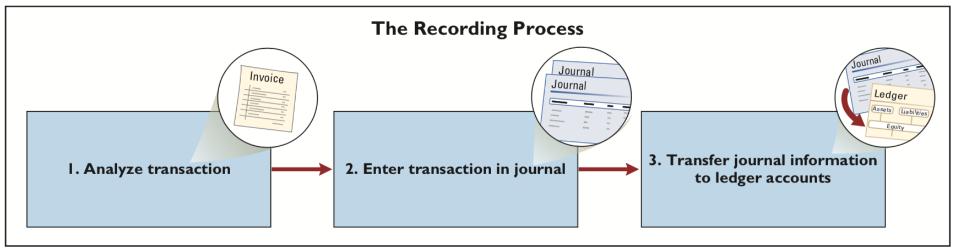

The Journal 분개장
1
2
3
1
2
3
LO 2

Slide 23
The Journal 분개장 Companies initially record transactions in chronological order. Thus, the journal is referred to as the book of original entry. (journalize 분개하다)
The journal makes several significant contributions to the recording process:
It discloses in one place the complete effects of a transaction.
It provides a chronological record 연대순 of transactions.
It helps to prevent or locate errors because the debit and credit amounts for each entry can be easily compared.
LO 2

Slide 24
Journalizing Assume: On September 1, Softbyte SA shareholders invested €15,000 cash in the corporation in exchange for ordinary shares, and Softbyte purchased computer equipment for €7,000 cash. Demonstrate: How do you enter the transaction data in the journal?
Continues on next slide
LO 2

Slide 25
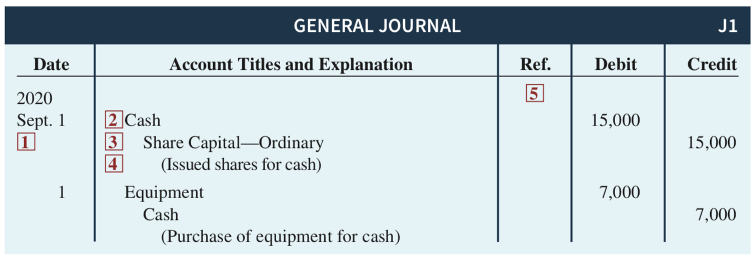






Journalizing
Date of the transaction.
Debit account title.
Credit account title. (대변 계정의 이름을 몇칸 들여서 기록한다)
Brief explanation (적요) of the transaction.
Reference column, which is left blank when the journal entry is made. This column is used later when the journal entries are transferred to the individual accounts of general ledger (총계정원장의 해당 계정번호)
LO 2

Slide 26
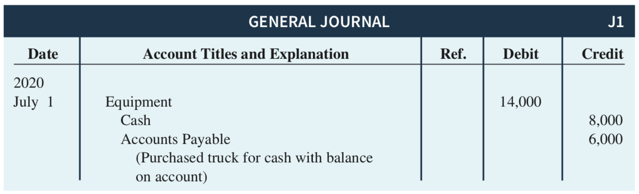

Simple and Compound Entries Simple entry: Involves one debit and one credit account. Compound entry: An entry that requires three or more accounts. The standard format requires that all debits be listed before the credits.
LO 2

Slide 27

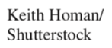
It Starts with the Transaction. Why is it important for companies to record financial transactions completely and accurately?
Accounting Across the Organization Hain Celestial Group
Answer and additional questions: See the book’s companion website.
LO 2

Slide 28
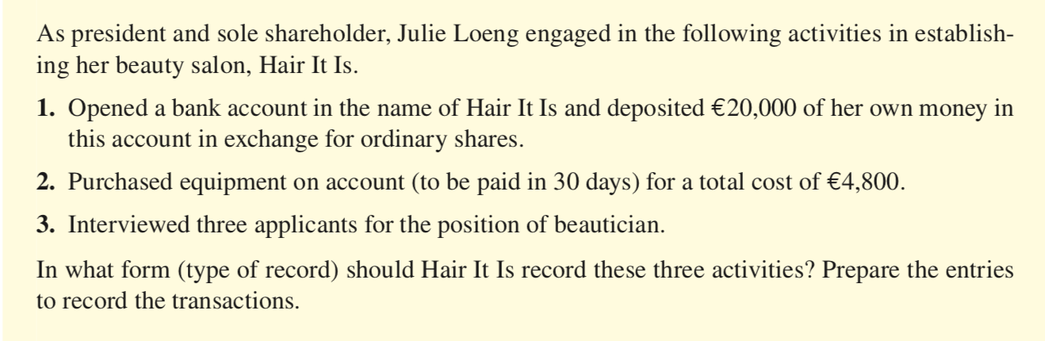
DO IT! Recording Business Activities
ACTION PLAN
Understand which activities need to be recorded and which do not. Any that have economic effect should be recorded in a journal.
Analyze the effects of transactions on asset, liability, and equity accounts.
LO 2

Slide 29
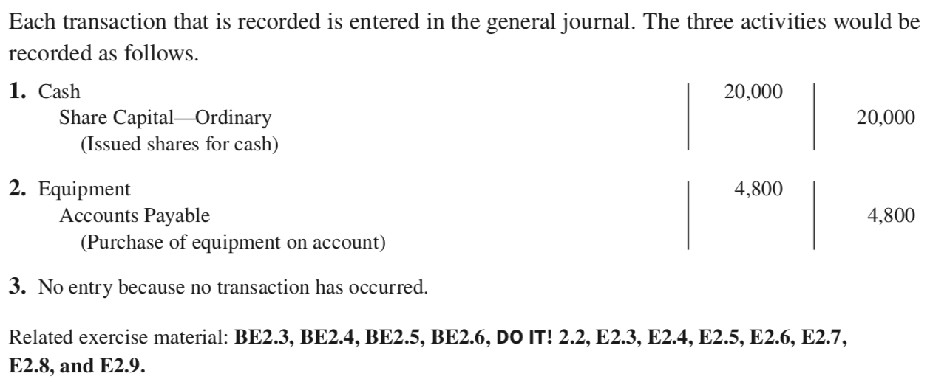
DO IT! Recording Business Activities
Solution
LO 2

Slide 30
Learning Objective 3 Explain how a ledger and posting help in the recording process.
LO 3

Slide 31
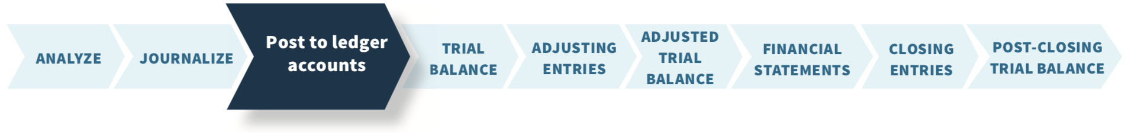
The Ledger and Posting
Ledger: The entire group of accounts maintained by a company.
Provides the balance in each of the accounts as well as keeps track of changes in these balances.
Companies may use various kinds of ledgers, but every company has a general ledger.
LO 3

Slide 32
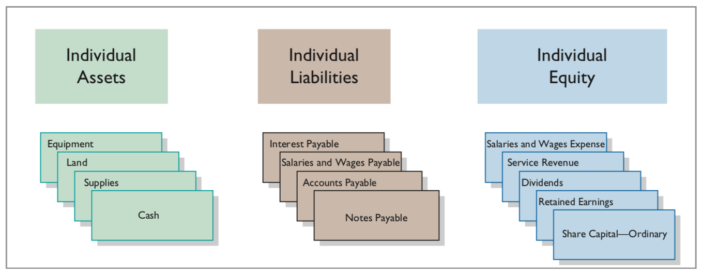
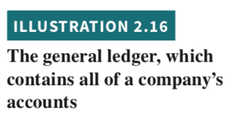
The Ledger 원장
The General Ledger 총계정원장
LO 3

Slide 33

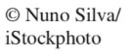
A convenient overstatement. What incentives might employees have had to overstate the value of these investment securities on the company’s financial statements?
Ethics Insight Credit Suisse Group
Answer and additional questions: See the book’s companion website.
LO 3

Slide 34
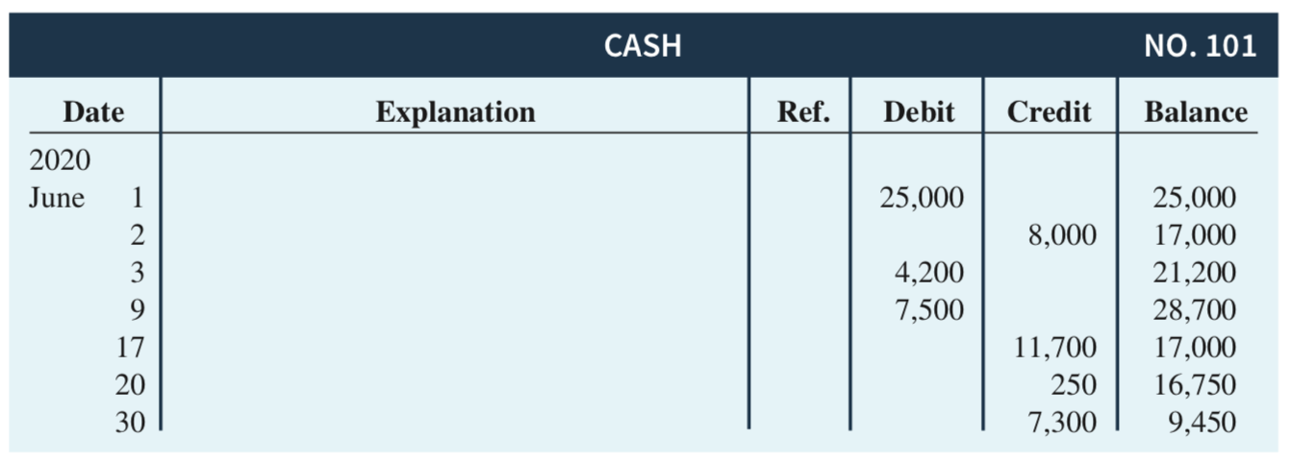

Standard Form of Account
This format is called the three-column form of account. It has three money columns—debit, credit, and balance.
LO 3

Slide 35
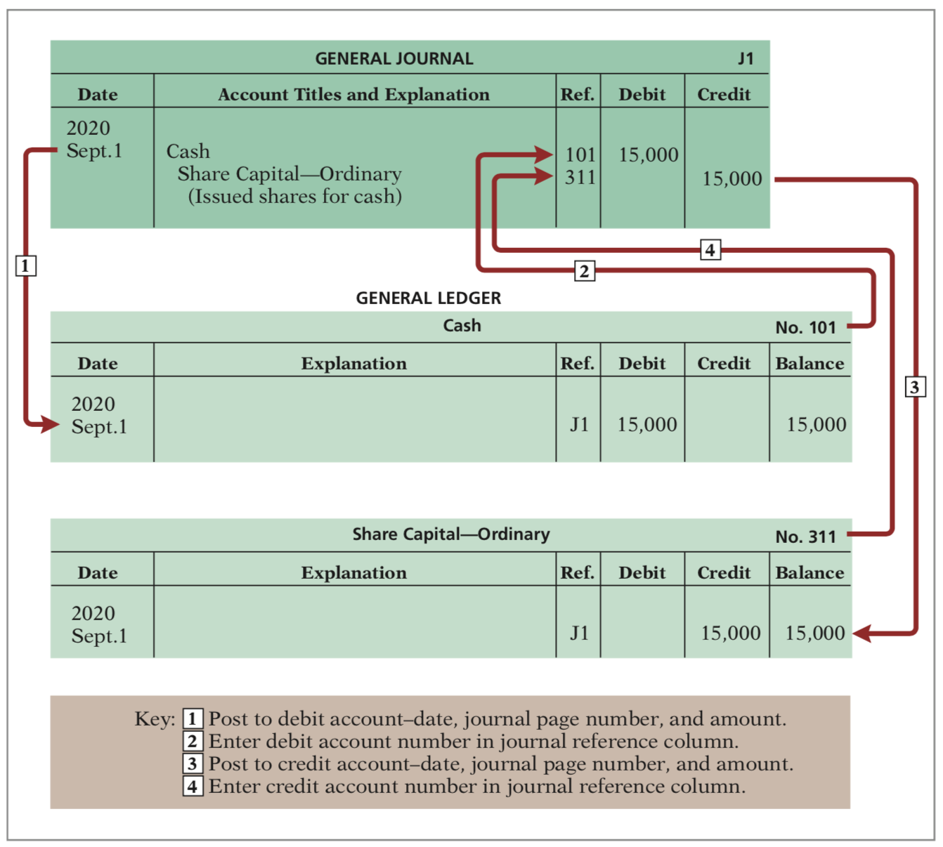

Posting 전기
LO 3

Slide 36
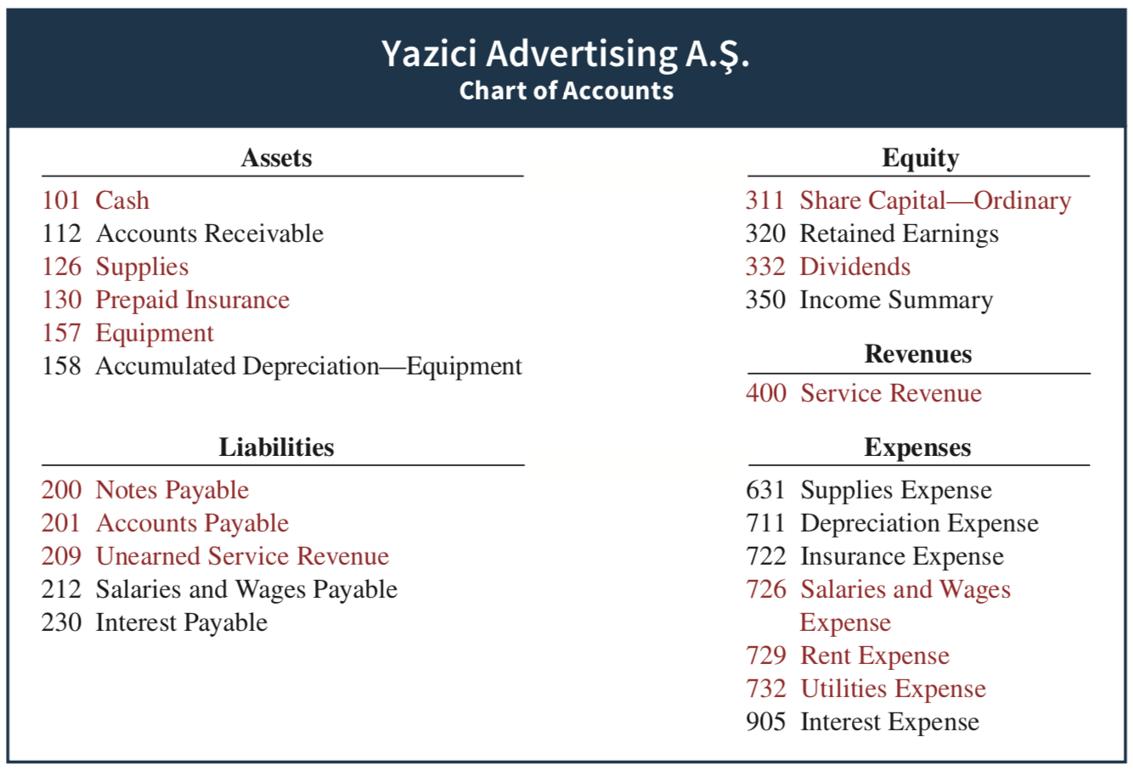

Chart of Accounts
Continues on next slide
LO 3

Slide 37
Chart of Accounts Lists the accounts and the account numbers that identify their location in the ledger. Numbering system: Usually starts with the statement of financial position accounts and follows with the income statement accounts. Number of accounts: Depends on the amount of detail management desires. Companies leave gaps to permit the insertion of new accounts as needed during the life of the business.
LO 3

Slide 38
The Recording Process Illustrated October transactions of Yazici Advertising A.Ş. Accounting period: One month HELPFUL HINT Follow these steps: 1 - Determine what type of account is involved. 2 - Determine what items increased or decreased and by how much. 3 - Translate the increases and decreases into debits and credits.
LO 3

Slide 39
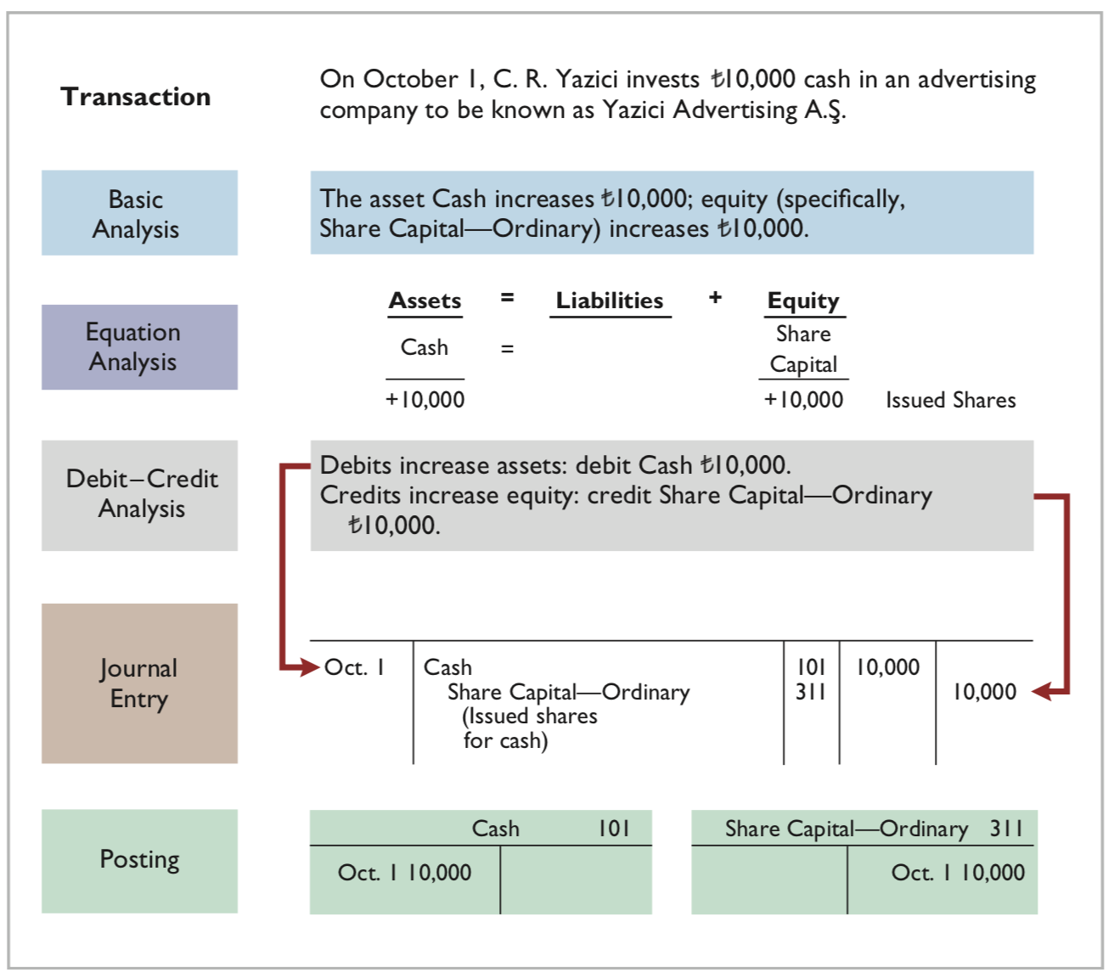
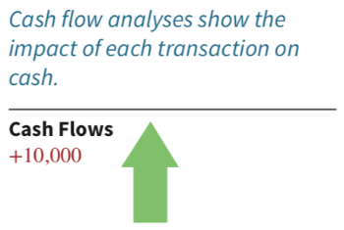

LO 3

Slide 40
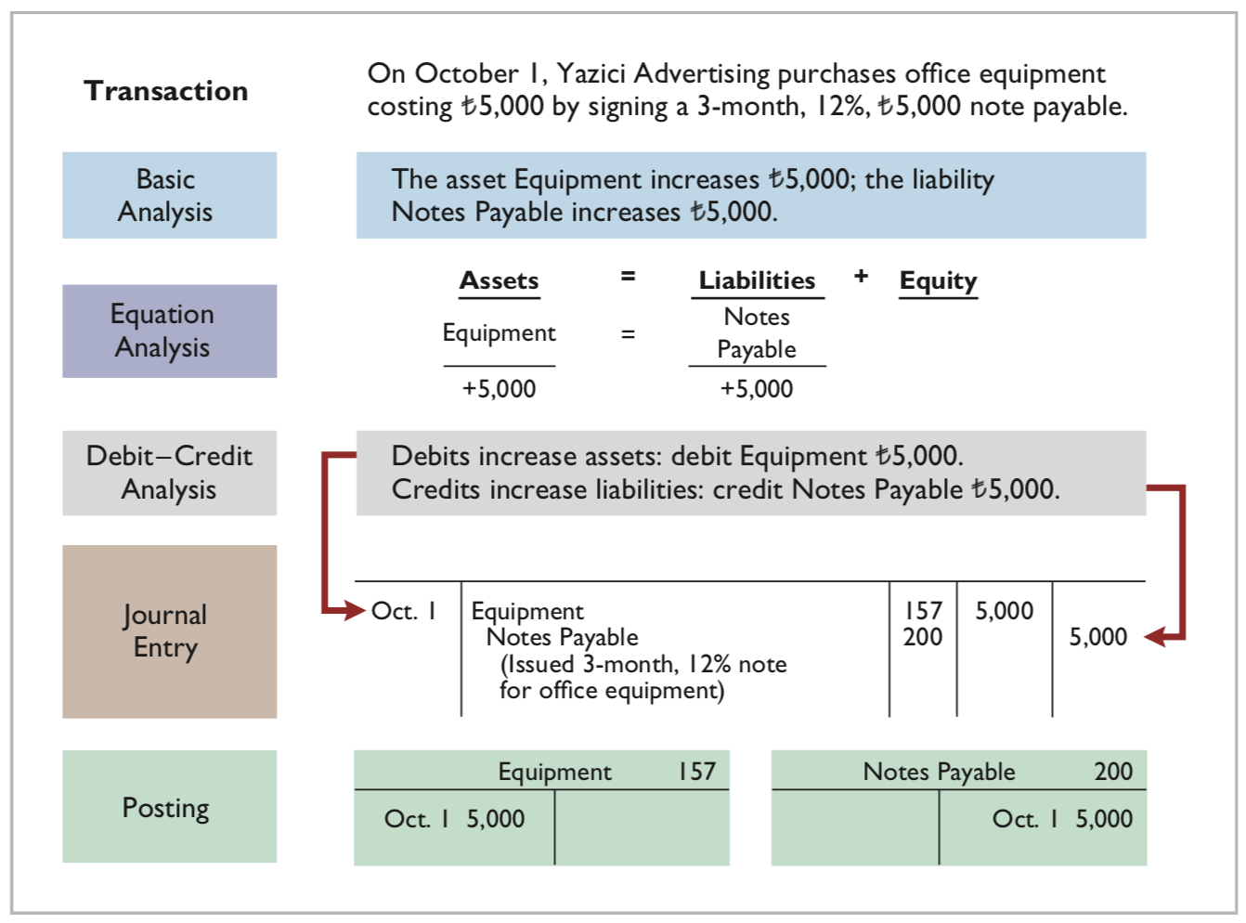


LO 3

Slide 41
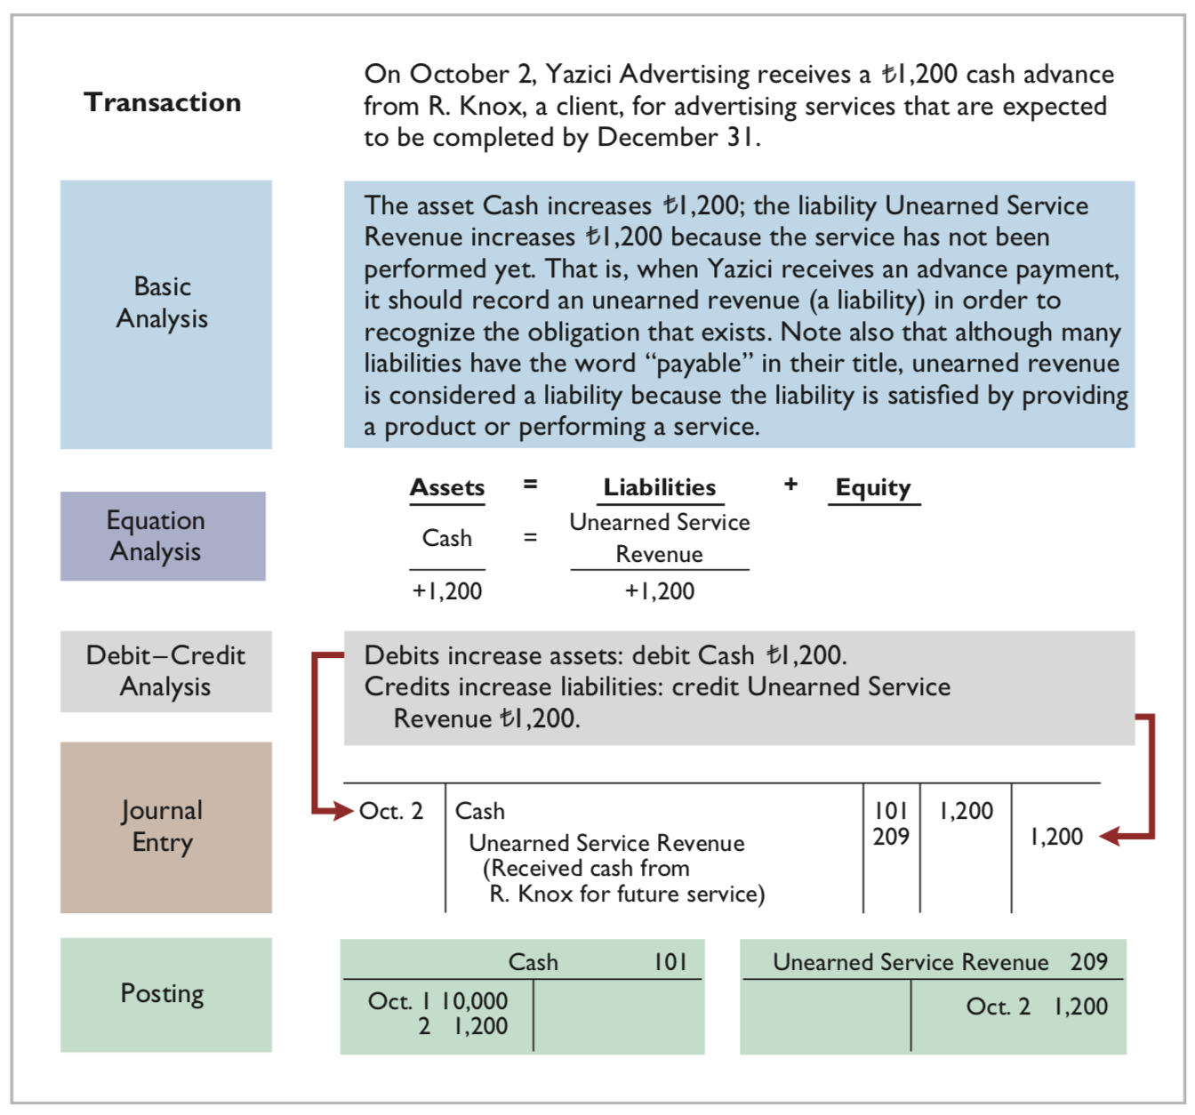
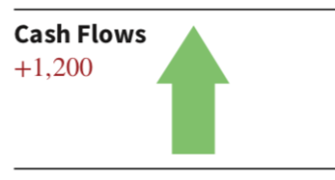

LO 3

Slide 42
Unearned Service Revenue is considered a liability even though the word payable is not used.
LO 3

Slide 43
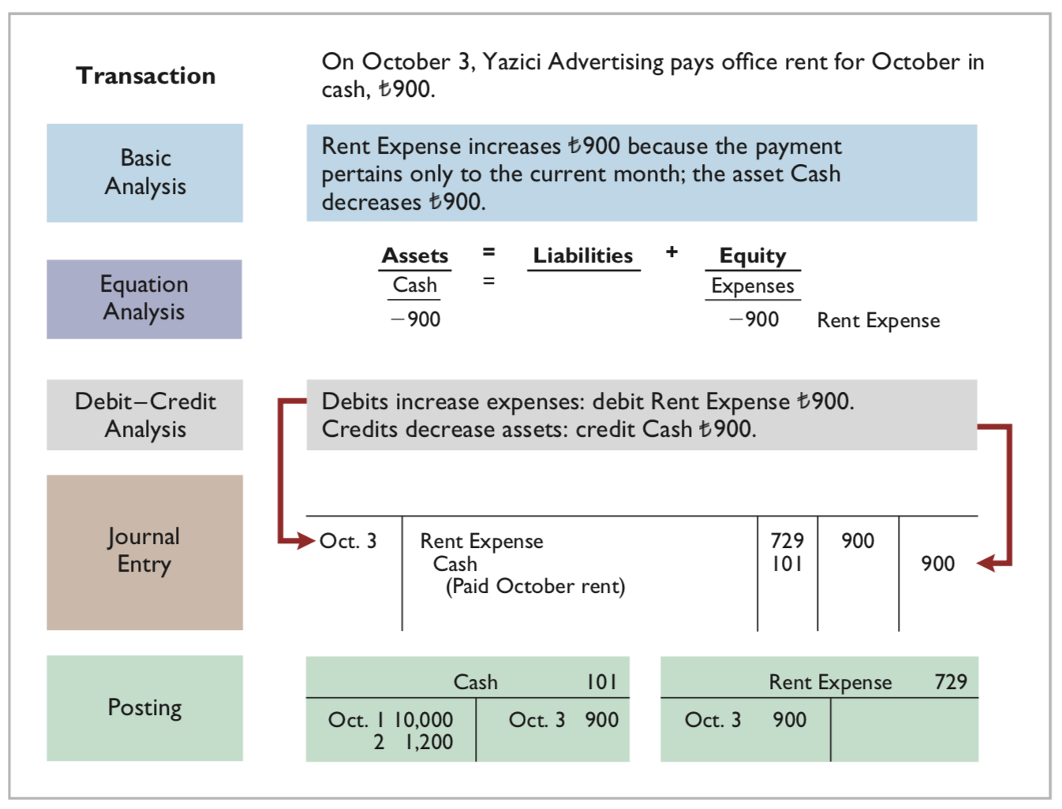


LO 3

Slide 44
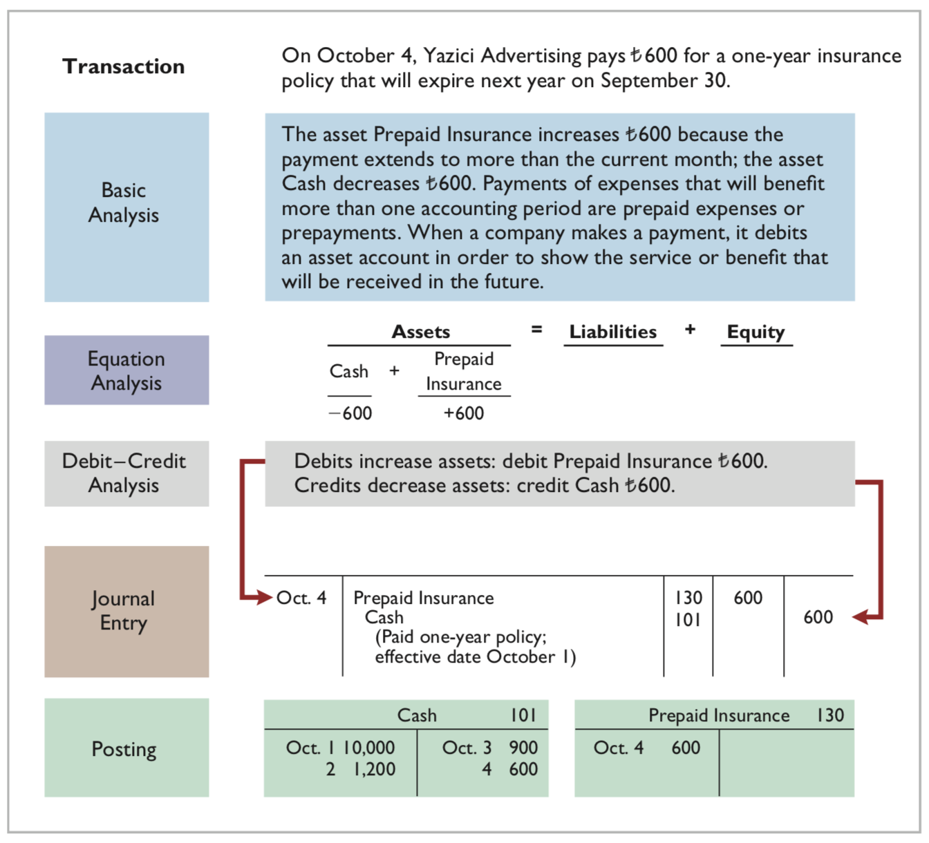
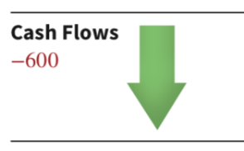

LO 3

Slide 45
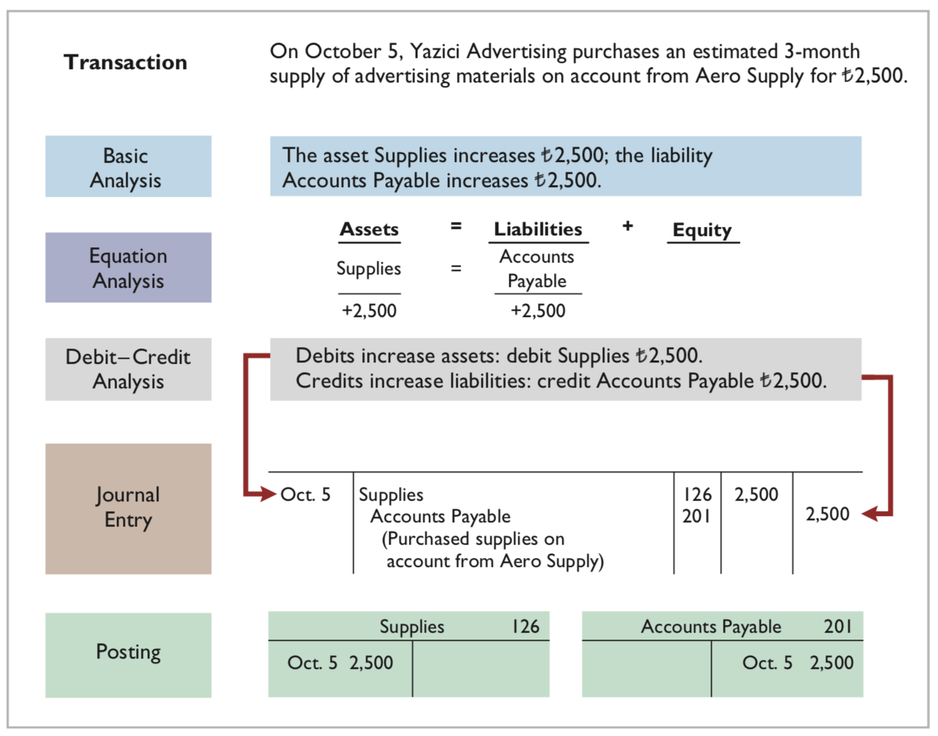


LO 3

Slide 46
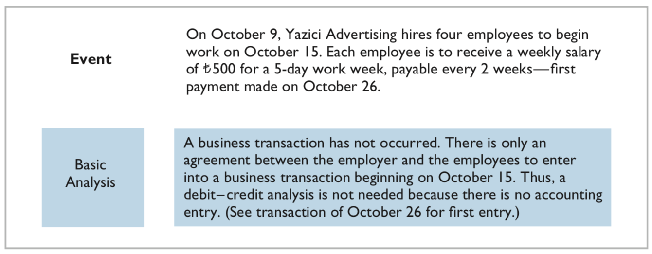


LO 3

Slide 47
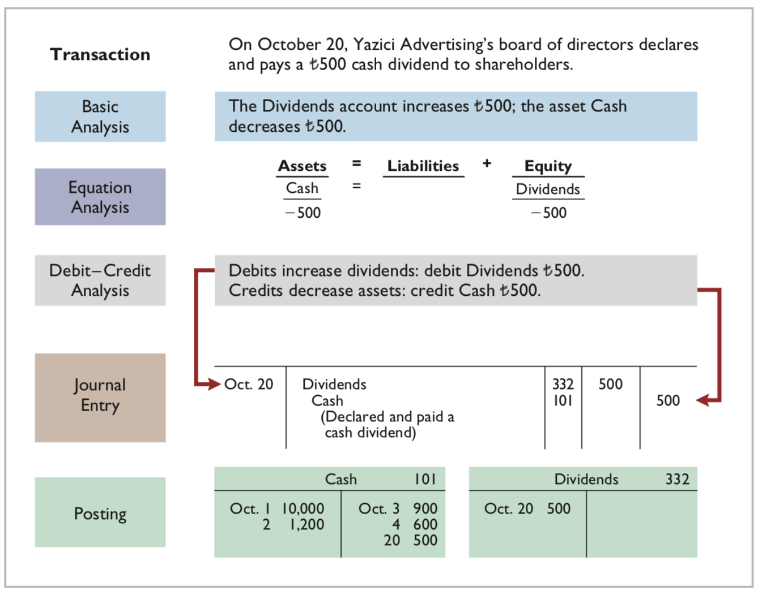
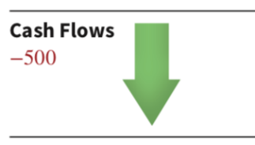
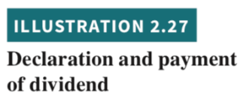
LO 3

Slide 48
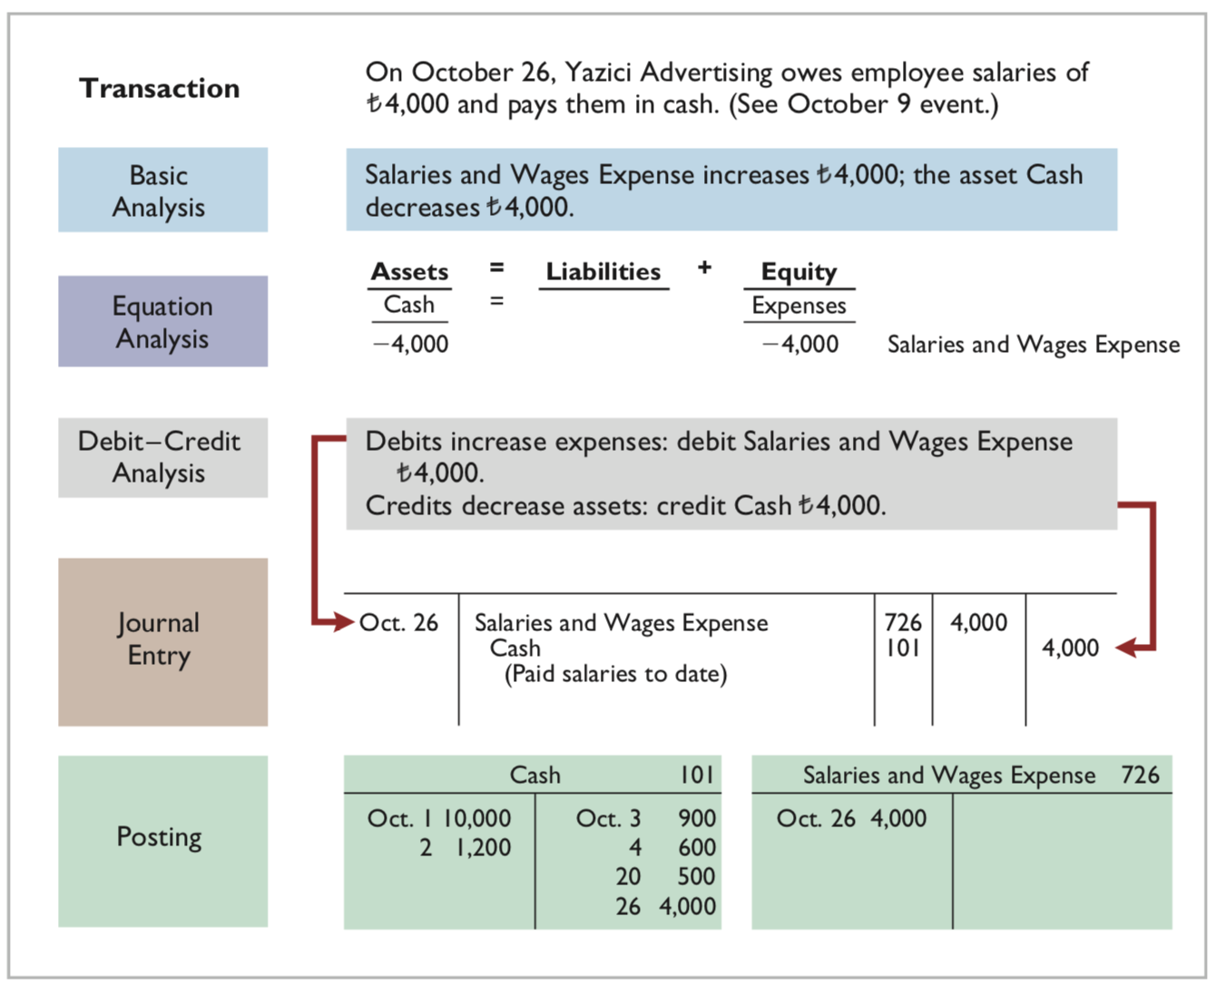


LO 3

Slide 49
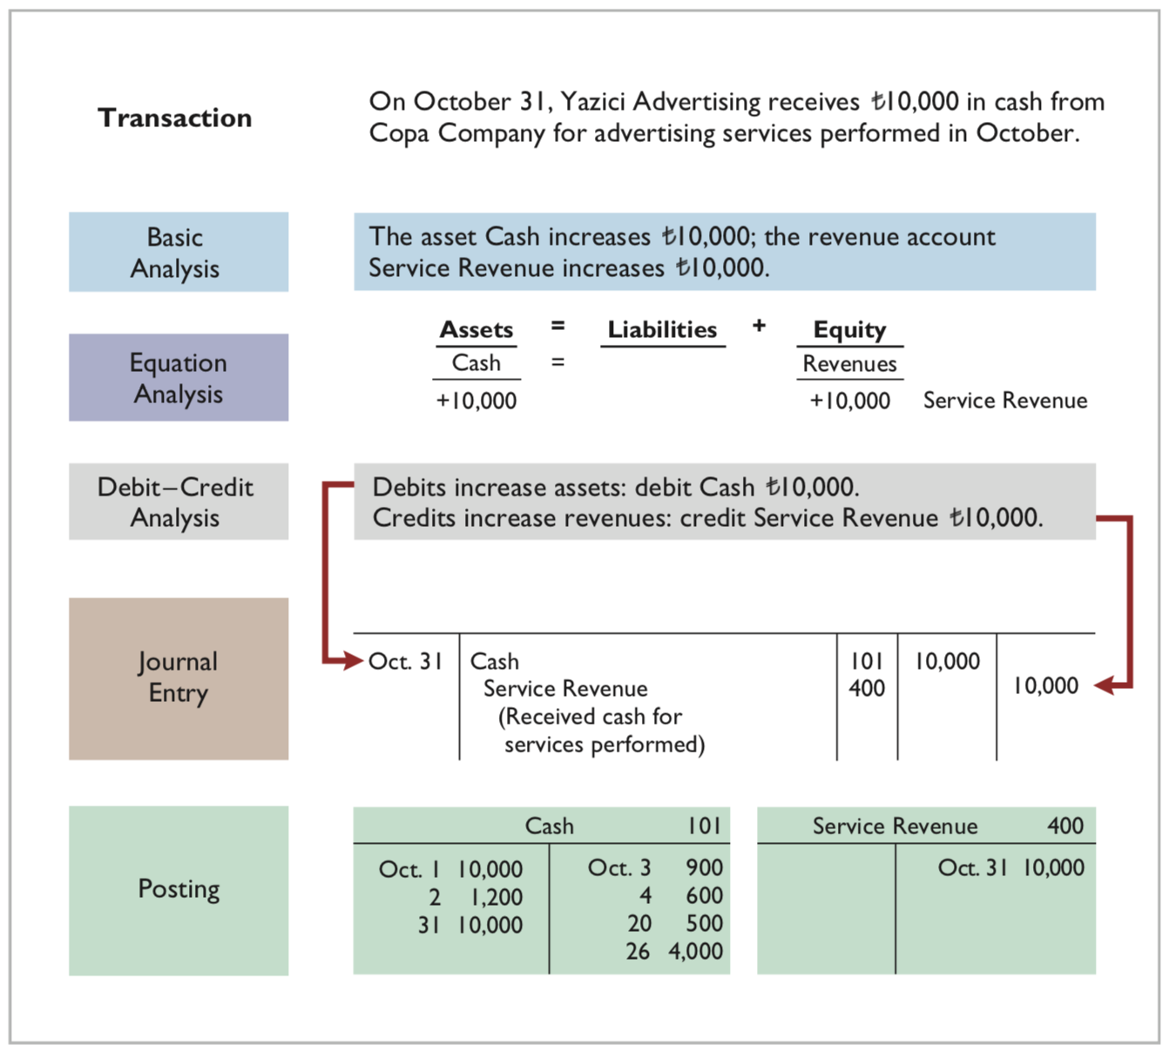
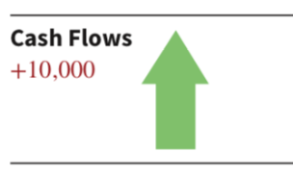
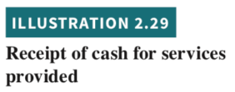
LO 3

Slide 50
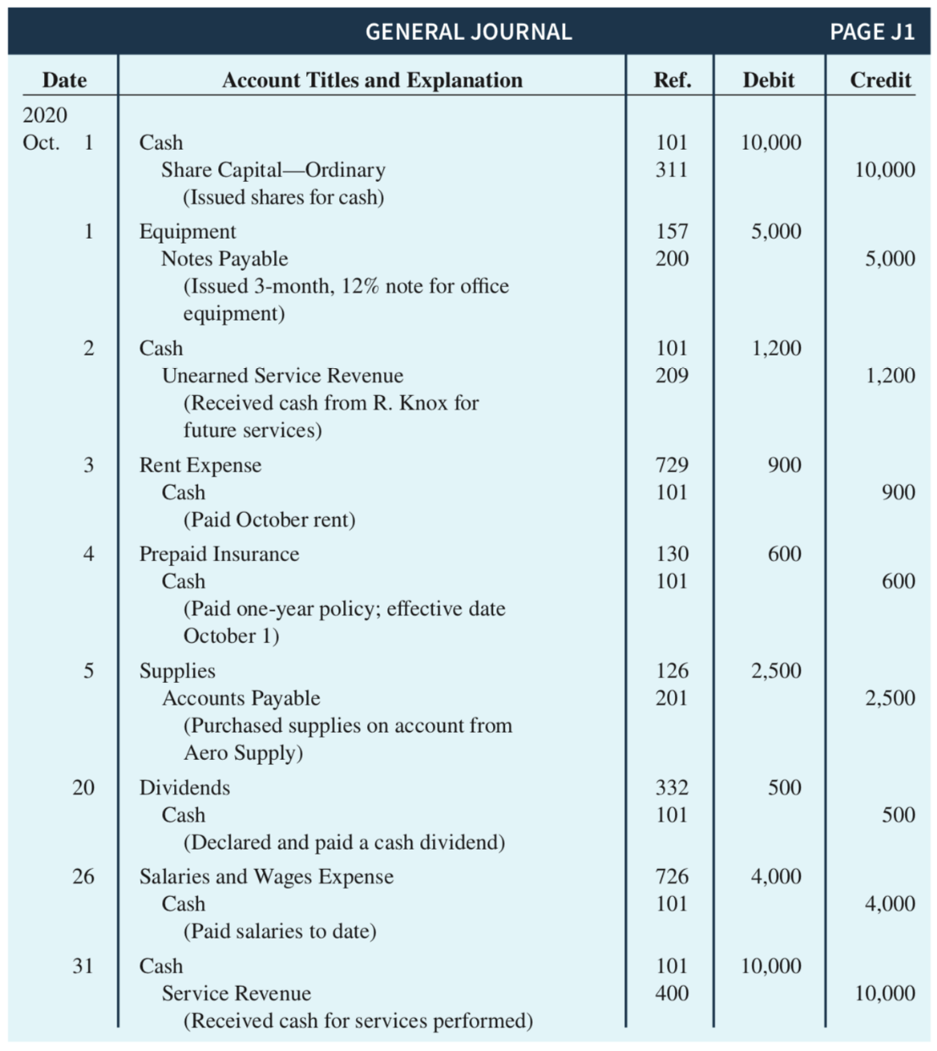

Summary Illustration of Journalizing and Posting
Continues on next slide
LO 3

Slide 51
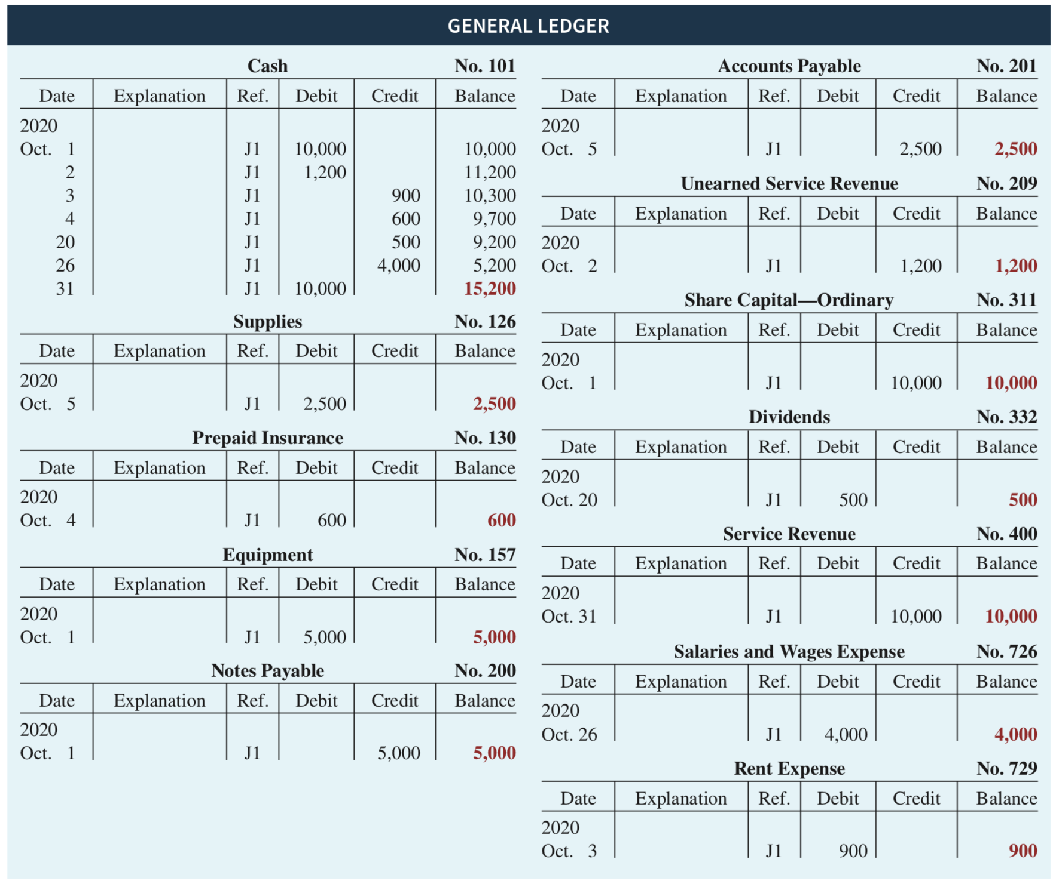

Summary Illustration of Journalizing and Posting
LO 3

Slide 52

DO IT! Posting
ACTION PLAN
Recall that posting involves transferring the journalized debits and credits to specific accounts in the ledger.
Determine the ending balance by netting the total debits and credits.
LO 3

Slide 53

DO IT! Posting
Solution
LO 3

Slide 54
Learning Objective 4 Prepare a trial balance 시산표.
LO 4

Slide 55

The Trial Balance
A list of accounts and their balances at a given time.
Proves the mathematical equality of debits and credits after posting.
Three steps of preparation:
List the account titles and their balances in the appropriate debit or credit column.
Total the debit and credit columns.
Verify the equality of the two columns.
LO 4

Slide 56


The Trial Balance
LO 4

Slide 57
Limitations of a Trial Balance A trial balance may balance even when: 1 - Transaction not journalized. 2 - Correct journal entry not posted. 3 - Journal entry posted twice. 4 - Incorrect accounts used in journalizing or posting. 5 - Offsetting errors made in recording the amount of a transaction.
ETHICS NOTE Error: The result of an unintentional mistake Neither ethical nor unethical
Irregularity: An intentional misstatement Viewed as unethical
LO 4

Slide 58
Trial Balance - Locating Errors
Determine the amount of the difference between the two columns of the trial balance.
Take one of the commonly useful steps as follows:
If the error is … | Then …
€1, €10, €100, or €1,000: | Re-add the trial balance columns and recompute the account balances.
Divisible by 2: | Scan the trial balance to see whether a balance equal to half the error has been entered in the wrong column.
Divisible by 9: | Retrace the account balances on the trial balance to see whether they are incorrectly copied from the ledger. For example, €12 instead of €21, called a transposition error.
Not divisible by 2 or 9: | Scan the ledger to see whether an account balance in the amount of the error has been omitted from the trial balance, and scan the journal to see whether a posting of that amount has been omitted.
LO 4

Slide 59
Currency Signs and Underlining
Currency Signs
Do not appear in journals or ledgers.
Typically used only in the trial balance and the financial statements.
Shown only for the first item and the total in the column.
Underlining
A single line is placed under the column of figures to be added or subtracted.
Totals are double-underlined.
LO 4

Slide 60
Copyright
Copyright © 2019 John Wiley & Sons, Inc.
All rights reserved. Reproduction or translation of this work beyond that permitted in Section 117 of the 1976 United States Act without the express written permission of the copyright owner is unlawful. Request for further information should be addressed to the Permissions Department, John Wiley & Sons, Inc. The purchaser may make back-up copies for his/her own use only and not for distribution or resale. The Publisher assumes no responsibility for errors, omissions, or damages, caused by the use of these programs or from the use of the information contained herein.

